Slide 1
Car License Plate Recognition with Noise Reduction
Young-Shiuan Hsu

Slide 2
Motivation
Goal: See how different filters affect the result of car license plate detection
Why?
Car license plate recognition systems are now widely used in law enforcement purposes, investigations, and even parking lots for addressing payments. However, a lot of stores do not have enough budget to upgrade their equipment so the images taken has poor quality. It could be very hard for the system to detect the symbols on the car license.
How?
To help improve the recognized digits on the car license plate, this project mainly focuses on how different noises affect the car license plate detection system. Moreover, implement different filtering techniques to improve the recognition results.

Slide 3
System design
First
Second
Last
Intentionally add white noise and peppered noise to the image to simulate a poor quality image. Design different filters.
We have to accurately detect the location of the car license plate in an image otherwise further operation will be meaningless if we did not find the location of the license plate.
Detect the car digits on the car license plate with EasyOCR (a package with text detection)

Slide 4
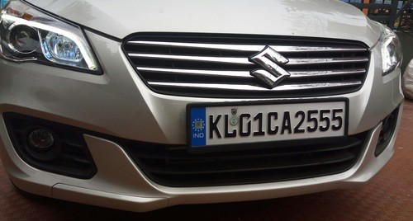
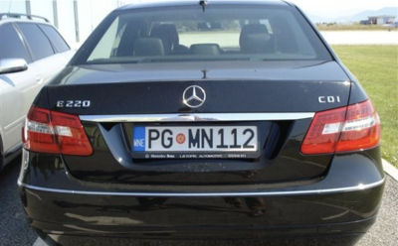
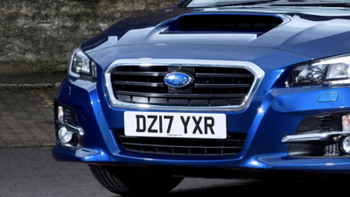
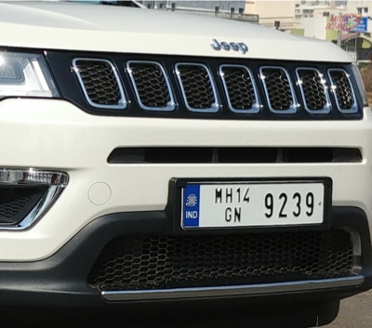
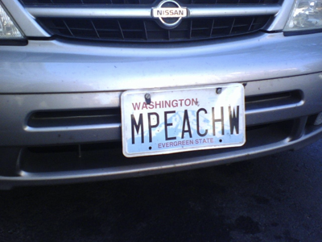
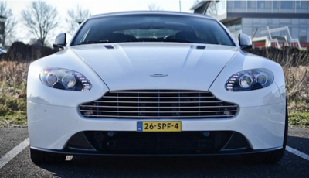
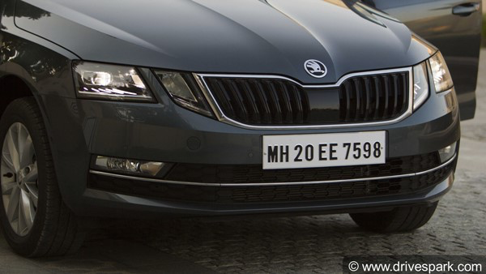
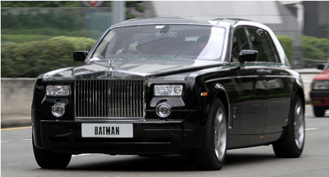
Database
https://www.kaggle.com/datasets/andrewmvd/car-plate-detection

Slide 5
1.
Add Noise
Produce multiple noisy images

Slide 6
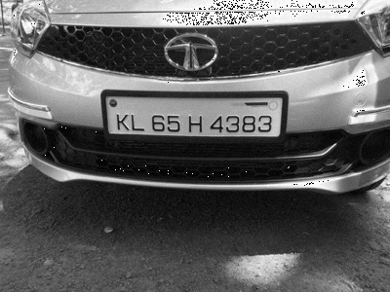
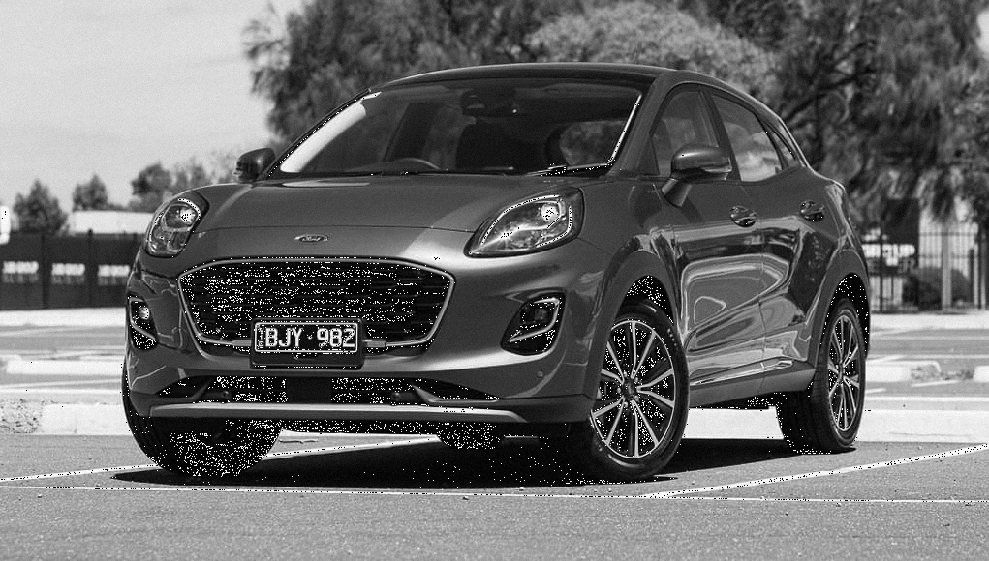
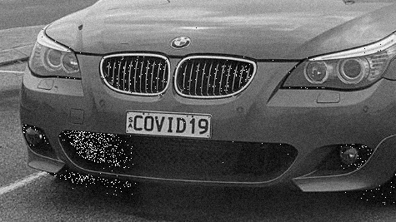
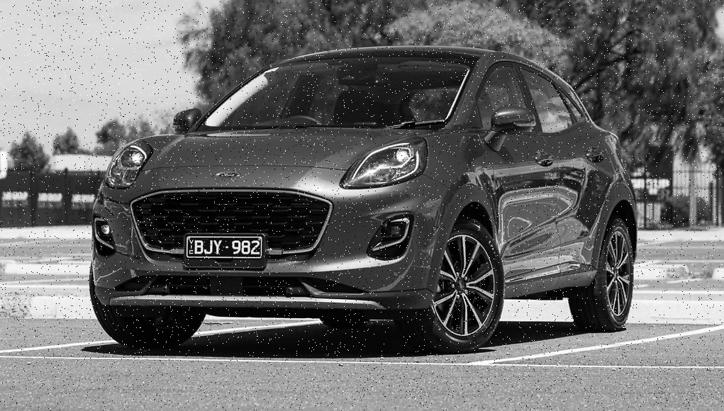
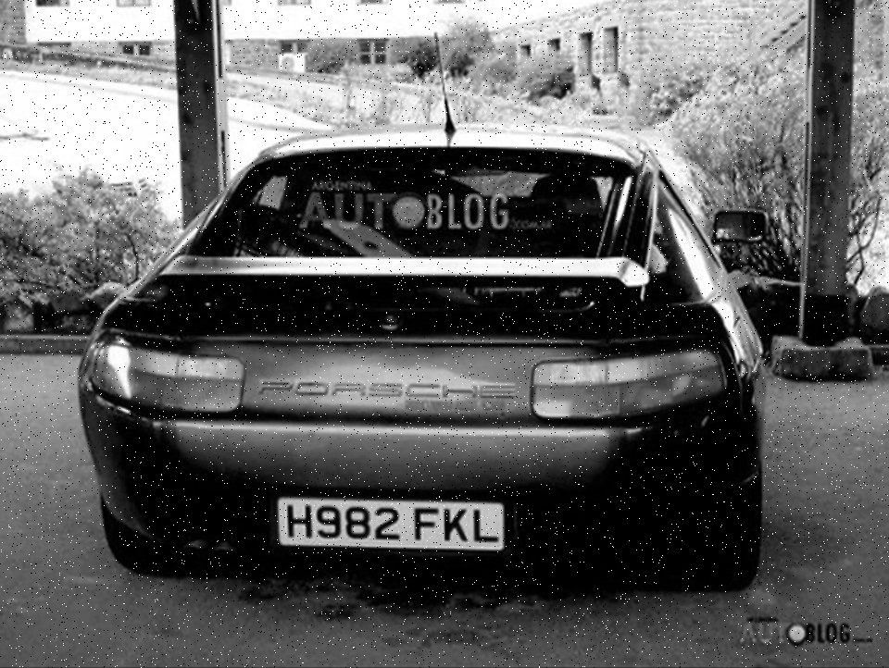
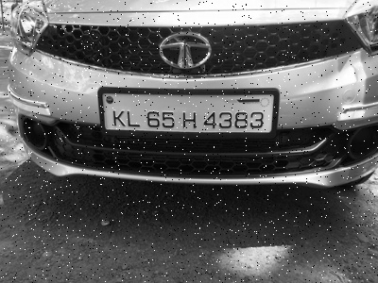
Add Gaussian white noise ~N(0,10)
Add Peppered and Salted noise

Slide 7
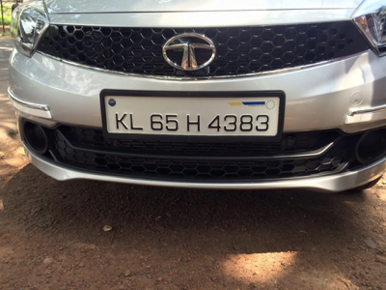


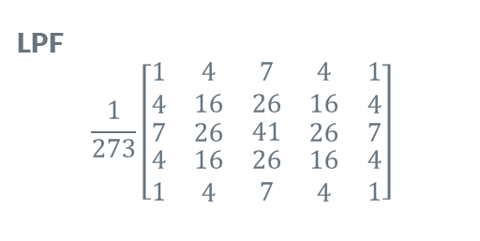
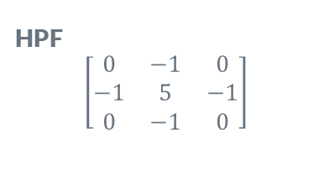
Filters
LPF
$$\frac{1}{273}\left[\begin{matrix}\begin{matrix}\begin{matrix}1 \\ 4\end{matrix} & \begin{matrix}4 \\ 16\end{matrix}\end{matrix} & \begin{matrix}7 \\ 26\end{matrix} & \begin{matrix}\begin{matrix}4 \\ 16\end{matrix} & \begin{matrix}1 \\ 4\end{matrix}\end{matrix} \\ \begin{matrix}7 & 26\end{matrix} & 41 & \begin{matrix}26 & 7\end{matrix} \\ \begin{matrix}\begin{matrix}4 \\ 1\end{matrix} & \begin{matrix}16 \\ 4\end{matrix}\end{matrix} & \begin{matrix}26 \\ 7\end{matrix} & \begin{matrix}\begin{matrix}16 \\ 4\end{matrix} & \begin{matrix}4 \\ 1\end{matrix}\end{matrix}\end{matrix}\right]$$
HPF
$$\left[\begin{matrix}0 & −1 & 0 \\ −1 & 5 & −1 \\ 0 & −1 & 0\end{matrix}\right]$$

Slide 8
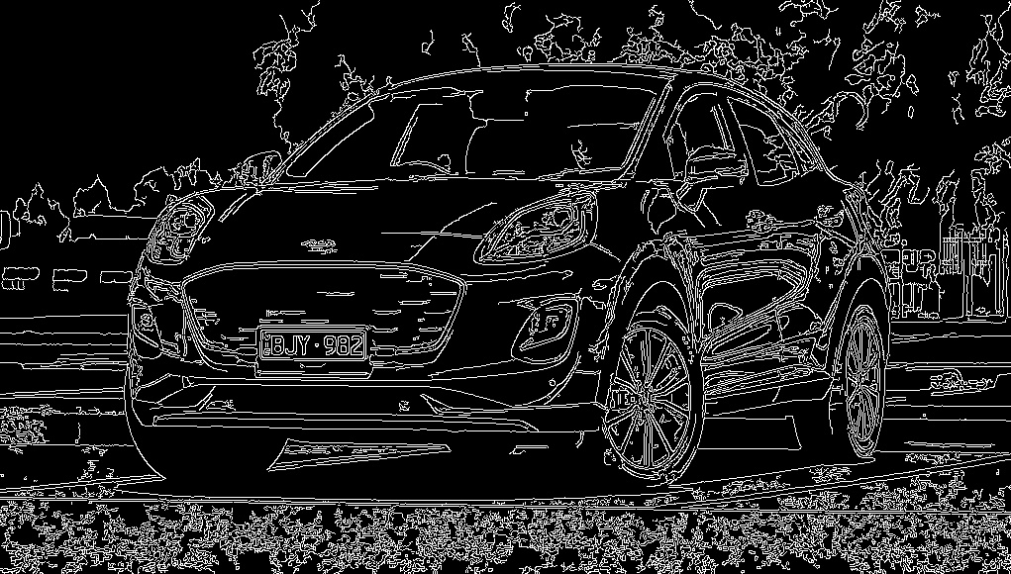
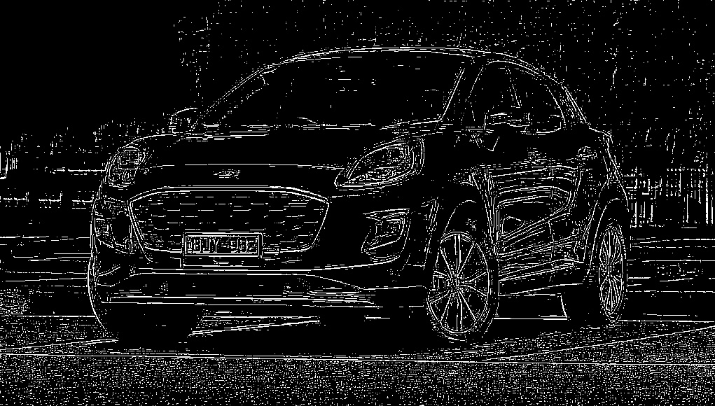
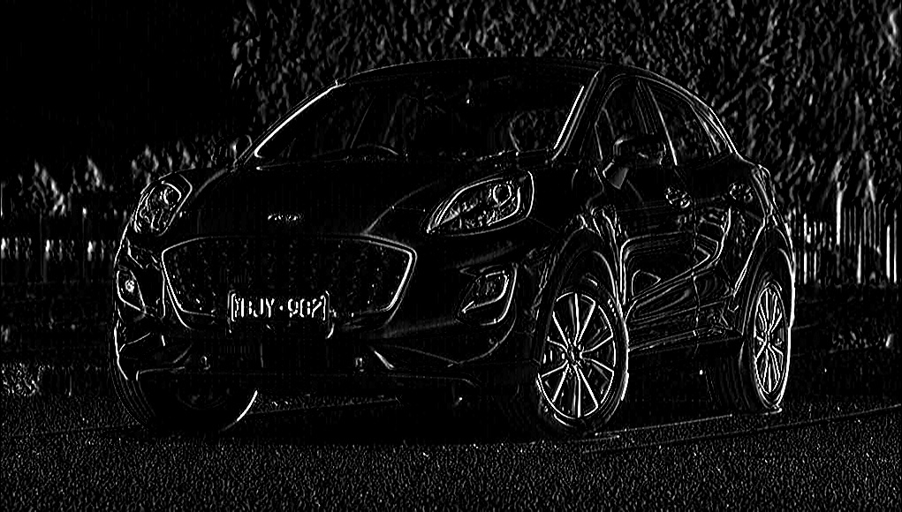
Filters(Edge Detection)
Canny Filter
Robert Filter
Sobel Filter

Slide 9
2.
License Plate detection
Detect the location of the license plate

Slide 10
Trying to do it with Machine Learning
Given the location of the car license plate we are able to train a model to detect the contours
Transfer Learning with VGG19 model
Accuracy after 75 epoch : 56.71%

Slide 11
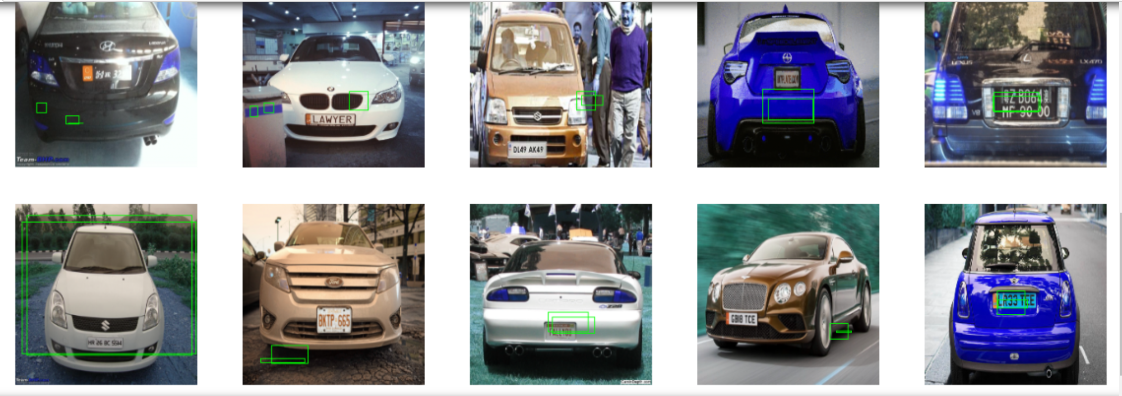
Unfortunately, it is not performing as I expected so I have to find another way to do it

Slide 12
With Filters and OpenCV package
Pass the image through a Bilateral filter
Pass the image through Canny filter
Find contours with OpenCV package
Extract the contours detected from the image
Using EasyOCR for text recognition

Slide 13
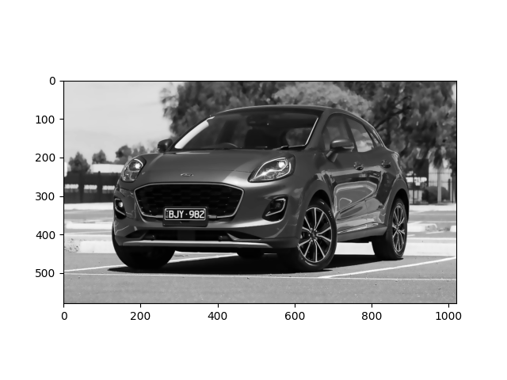
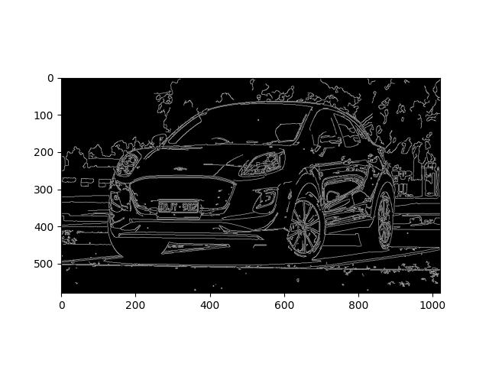
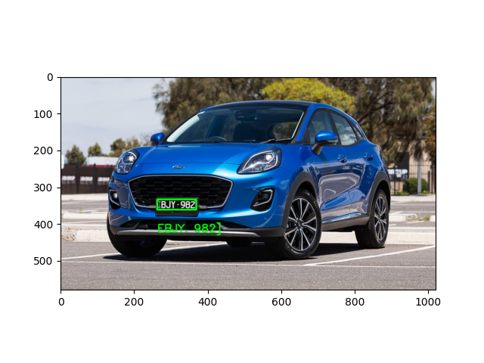
Implement with original image

Slide 14
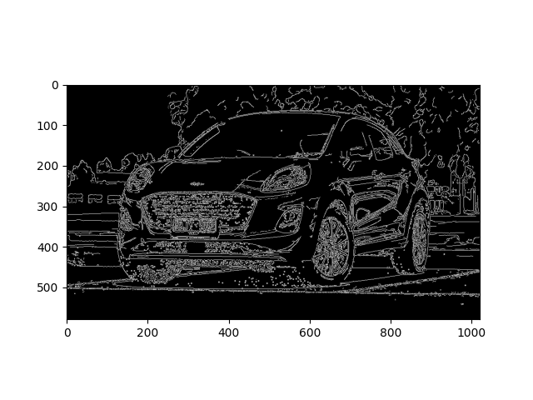
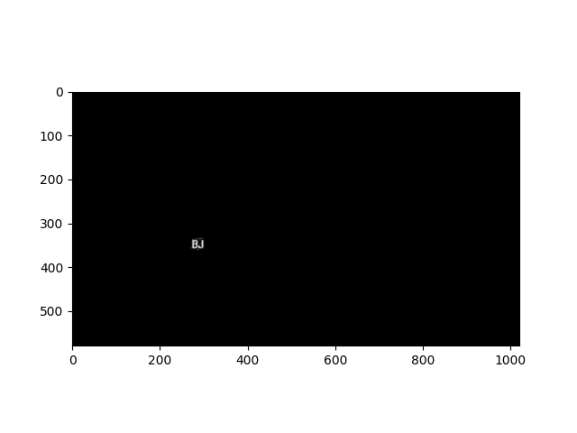
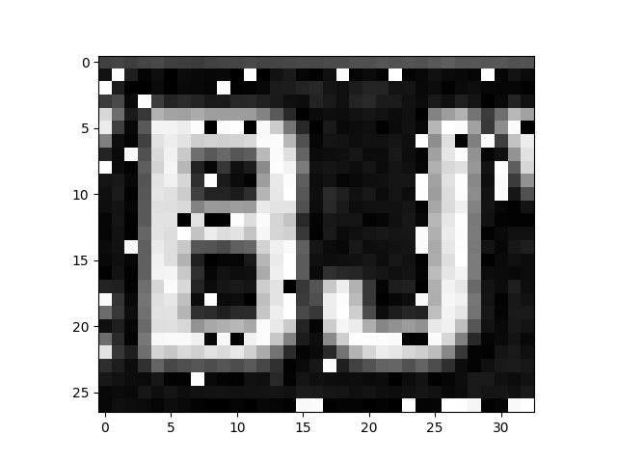
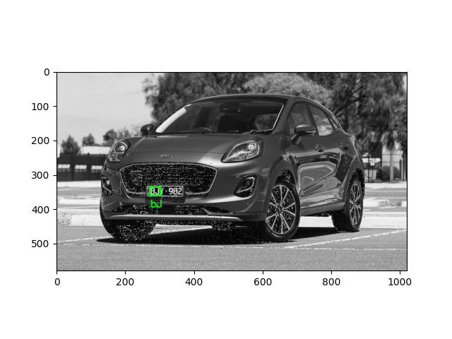
Gaussian white noise image

Slide 15
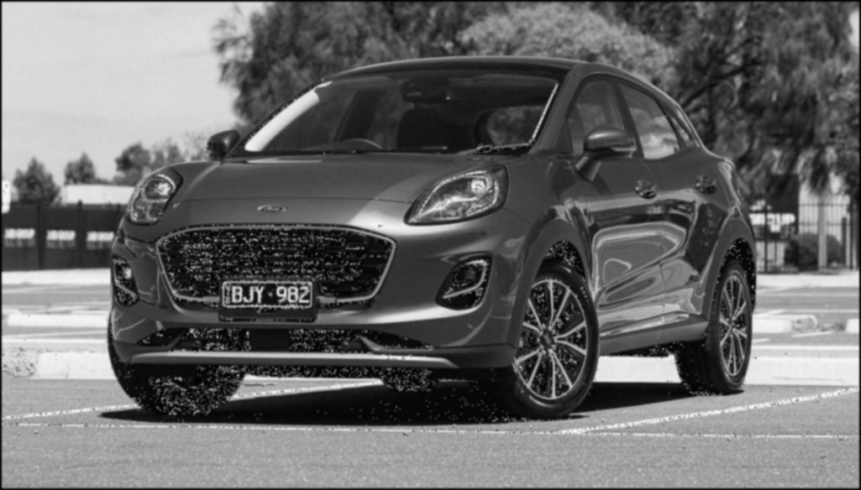
Noise Reduction
We know that low pass filters could help us fight white noise
Since LPF blurs the image, I apply a high pass filter to sharpen the image

Slide 16
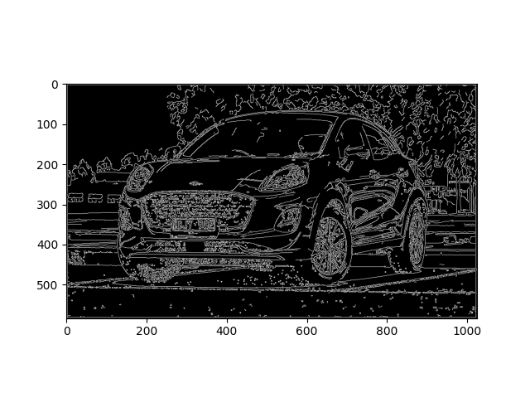
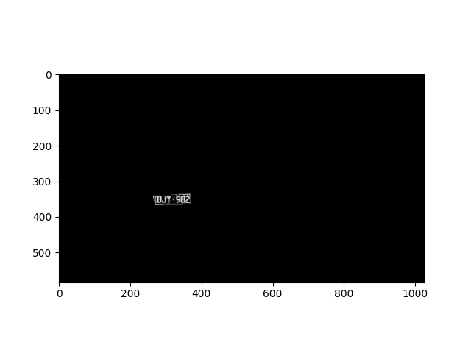

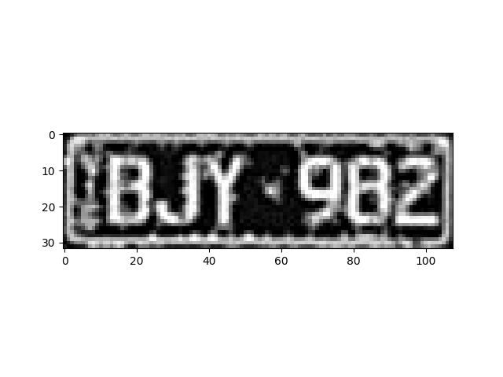
Noise Reduction

Slide 17
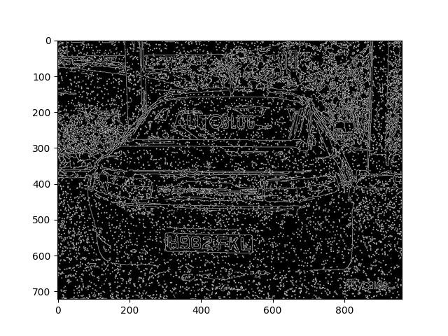
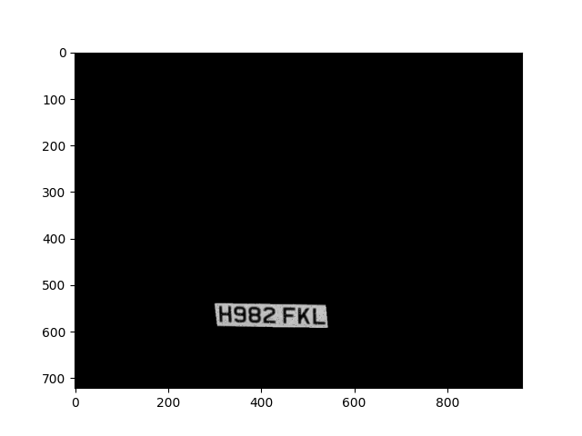
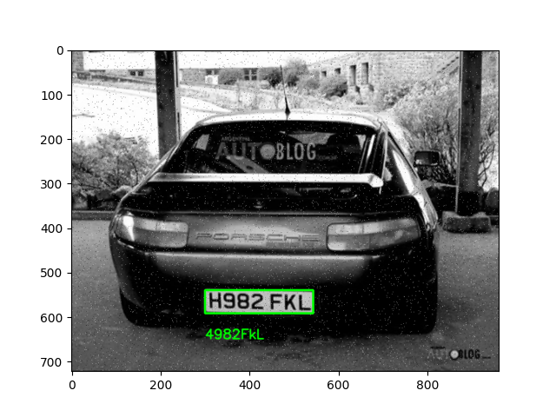
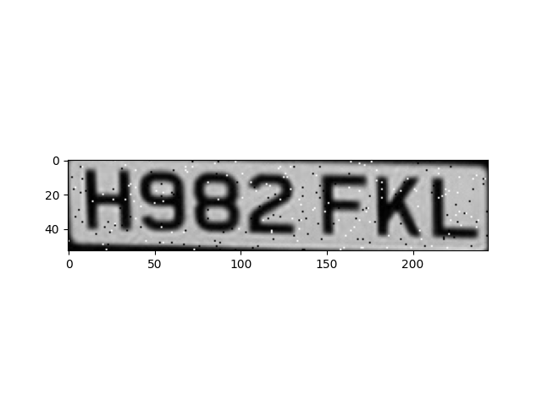
Peppered and Salted Noise

Slide 18

Noise Reduction
From Test1 we have observed that median filter can help us fight peppered and salted noise

Slide 19
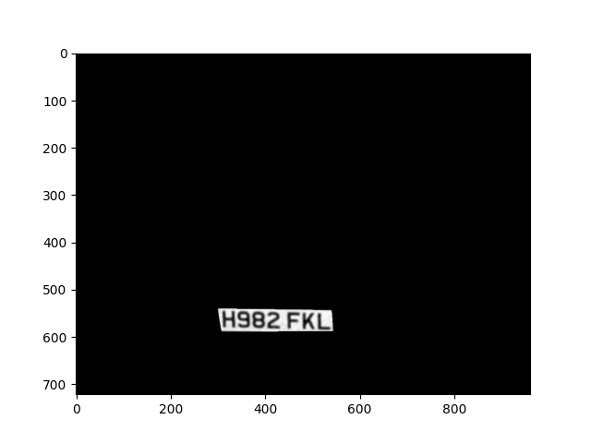
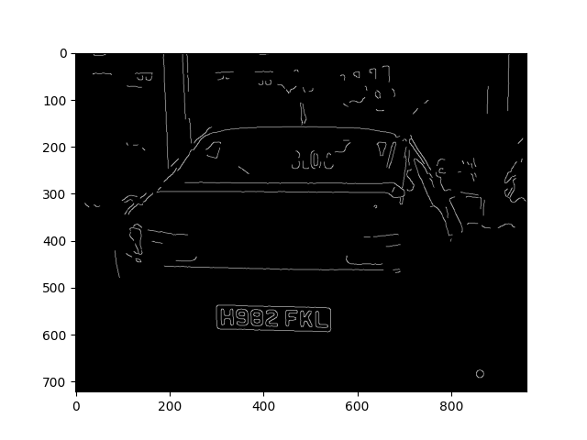
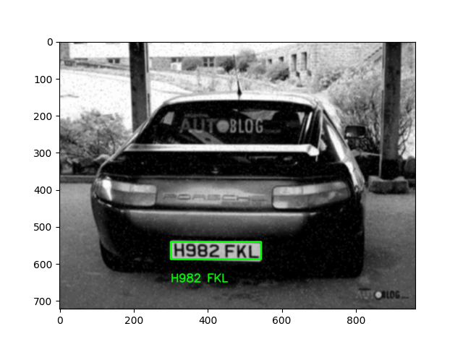
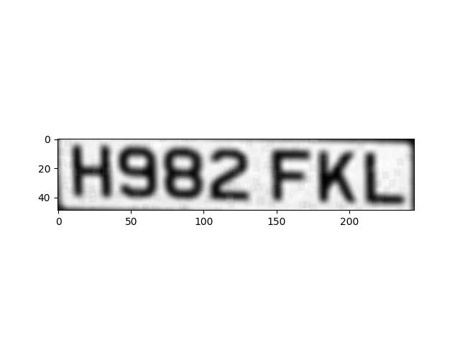
Noise Reduction

Slide 20
3.
Demo

Slide 21
4.
Difficulties

Slide 22
Difficulties
Training the model for contour detection and finding another solution
Finding different parameters for Canny filter that could bring the best performance
Integrating different functions I tried into one main function

Slide 23
Thank you!

